Slide 1
A Fraction as a Percent
Unit 1 Lesson 7
Math 6

Slide 2
A Fraction as a Percent
Students will be able to:
Write fraction as percent and decimal.
Write percent as fraction and decimal.
Solve problems involving fractions, percent and decimals.

Slide 3
A Fraction as a Percent
Key Vocabulary:
Fraction
Decimal
Percent
Part-to-Whole Ratio

Slide 4
A Fraction as a Percent
A Fraction as a Percent
Look at the figure below. There are 5 hearts, three are RED and two are BLACK.

Slide 5
A Fraction as a Percent
The figure in the previous slide has two PART-TO-WHOLE ratios.

Slide 6
A Fraction as a Percent
What percent of the hearts is RED? What percent of the hearts is BLACK? Note that a part-to-whole ratio is more useful in comparing percent. Also note the “whole” means 100!
How are you going to find the percentage, given that the second term of the ratio or the denominator of a fraction is not 100?
3:5 = ?% and 2:5 = ?%

Slide 7
A Fraction as a Percent
Changing Fractions to Percent and Decimal
To change a fraction with a denominator which is not 100, follow these steps:
What percent of the hearts is RED?

Slide 8
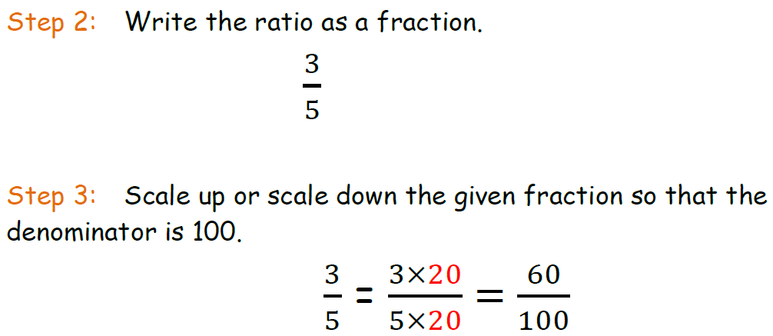
A Fraction as a Percent
Changing Fractions to Percent and Decimal

Slide 9
A Fraction as a Percent
Changing Fractions to Percent and Decimal

Slide 10
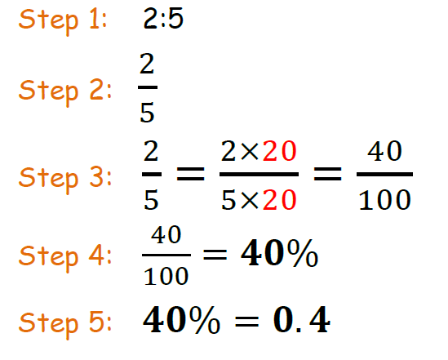
A Fraction as a Percent
What percent of the hearts is BLACK?

Slide 11
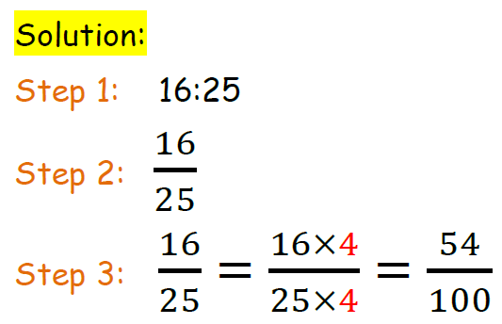
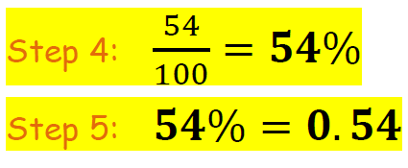
A Fraction as a Percent
Sample Problem 1:
Write $\frac{16}{25}$ as percent and decimal.

Slide 12
A Fraction as a Percent
Changing Fractions to Percent and Decimal (The Easier Way!)
The following steps show an alternative way to write fraction as percent and decimal. But in a case like this…you need to write it as decimal first and then percent. Let’s go back to the RED and BLACK hearts.

Slide 13
A Fraction as a Percent

Slide 14
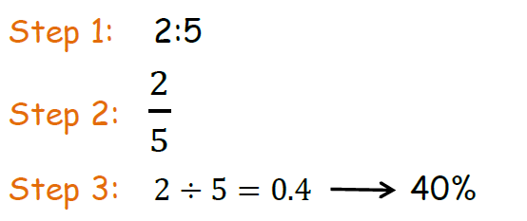
A Fraction as a Percent
What percent of the hearts is BLACK?

Slide 15
A Fraction as a Percent
Changing Fractions to Percent and Decimal with Denominators that are NOT Factors of 100
If the denominator of a fraction is not a factor of 100, these steps can help you change it to percent and decimal.

Slide 16
A Fraction as a Percent
Example: Write $\frac{3}{8}$ as percent and decimal.
Step 1: Divide the numerator and denominator.
$\frac{3}{8}$ = 0.38
Step 2: Change it to percent.
0.38 = 38%

Slide 17
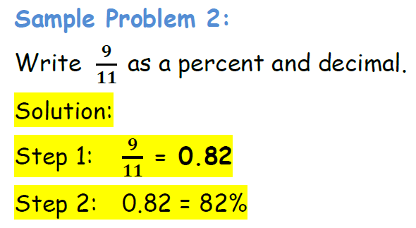
A Fraction as a Percent
In cases like these, there is no other way to do it but to change the fraction to decimal first, then to percent. It cannot go the other way around.

Slide 18
A Fraction as a Percent
The order of changing fractions, decimals and percent into whatever forms share a certain relationship. And there is no really particular order of steps to follow, except if the denominator of the fraction is not a factor of 100. You can convert them into different forms without any particular order as long as the process is well supported and valid.

Slide 19
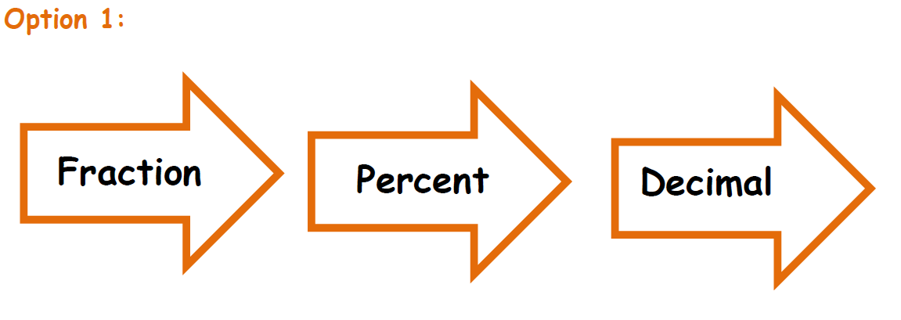
A Fraction as a Percent

Slide 20
A Fraction as a Percent

Slide 21
A Fraction as a Percent
Sample problem 3:
Sam had already spent $\frac{3}{4}$ of his monthly allowance.
What percent of his allowance did he already spend?
What percent of his allowance does he have left?
Express the allowance he has left in fraction.

Slide 22
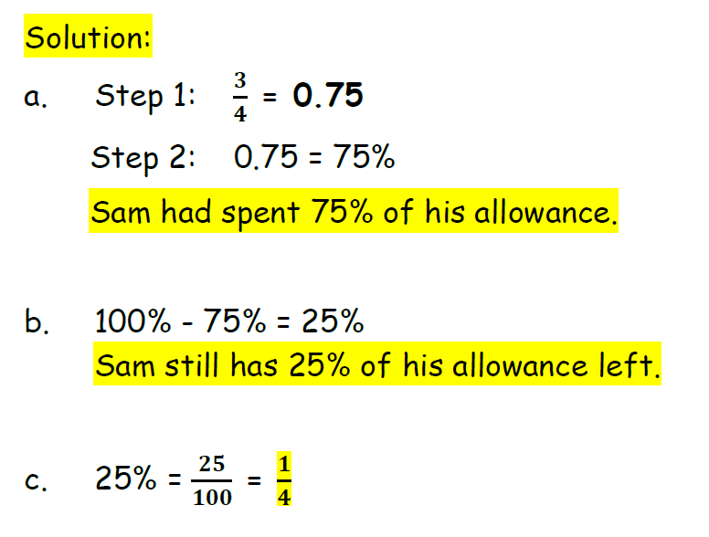
A Fraction as a Percent

