Slide 1

Proportions
Unit 1 Lesson 5
Math 6

Slide 2

Proportions
Students will be able to:
Define proportions.
Determine whether a given proportion is true or false.
Find the unknown value in a proportion.
Solve problems using proportions.

Slide 3
Proportions
Key Vocabulary:
Ratio
Proportion
Cross Multiplication
Equality
Fractions

Slide 4
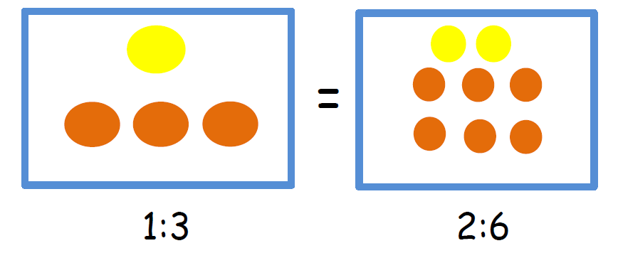
Proportions
Proportions
A proportion is the equality of two ratios (or fractions).

Slide 5
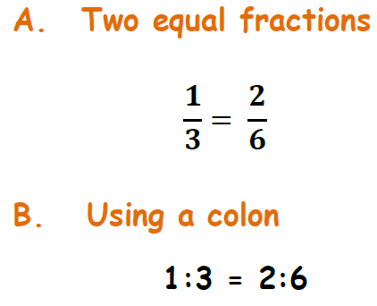
Proportions
How do we write proportions?
Proportions can be written as follows:

Slide 6
Proportions
Is the proportion TRUE or FALSE?
To determine whether given proportion is TRUE or FALSE, we use the process of “cross multiplication”.
Example: Tell whether the given proportion
3:4 = 15:20 is true or false.

Slide 7
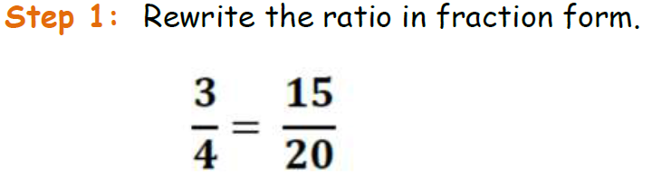
Proportions
Example: Tell whether the given proportion
3:4 = 15:60 is true or false.

Slide 8
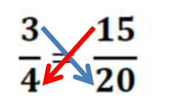
Proportions
Step 2: Multiply the numerator of the first ratio by the denominator of the other ratio, and the numerator of the second ratio by the denominator of the first ratio.

Slide 9
Proportions
Step 3: If the product are equal, then the proportion is TRUE. If not then the proportion is false.

Slide 10

Proportions
Sample Problem 1:
Tell whether the given proportions are TRUE or FALSE,

Slide 11
Proportions
Finding the Unknown in a Proportion
If it is known that the given ratios are proportional, then you can easily find the unknown quantity in a proportion.
Example:
Solve for x in the proportion x:4 = 15:20.

Slide 12
Proportions
Example:
Solve for x in the proportion x:4 = 15:20.
Step 1: Write the given proportion in fraction form.

Slide 13
Proportions

Slide 14
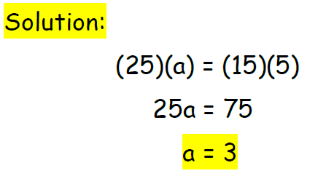
Proportions
Sample Problem 2:
Find the unknown in the proportion 15:a = 25:5.

Slide 15
Proportions
Solving Problems Using Proportions
A lot of real life problems can be solved using the concept of proportions.

Slide 16
Proportions
Example:
A photographer wants to enlarge a photograph with width 6 inches and length 9 inches. He wants to make the length of the new photograph 12 inches, but still want to keep the proportion of the width to length. What is the width of the enlarged photograph?

Slide 17
Proportions
Solution:
Step 1: Determine the relationship of the ratio in the given problem.
width : length

Slide 18
Proportions
Step 2: Write a ratio that compares the quantities given in the problem.
Original photo - 6 inches : 9 inches
Enlarged photo – x : 12 inches

Slide 19
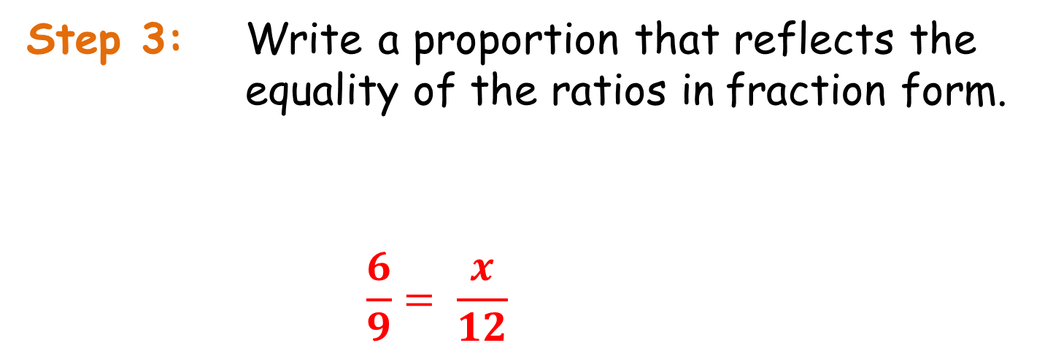
Proportions
Step 3: Write a proportion that reflects the equality of the ratios in fraction form.
$$\frac{6}{9}= \frac{x}{12}$$

Slide 20
Proportions
Step 4: Solve for x.
9x = 72
x = 8
Therefore the enlarged photo has a width of 8
inches and 12 inches length.

Slide 21
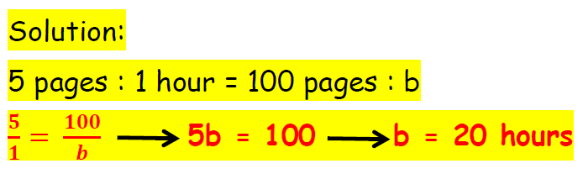
Proportions
Sample Problem 3:
Chris can type 5 pages in an hour. How long will it take him to complete 100 pages?

